Slide 1


DevOps Culture and Practice Enablement
Retrospectives Overview

Slide 2
RETROSPECTIVE: What is it?
A practice used by their teams to reflect on their way of working, and continuously become better in what they do. They are meant to help teams keep improving.
At regular intervals, the team reflects on how to become more effective, then tunes and adjusts its behavior accordingly - 12th Principle of the Agile Manifesto
2

Slide 3
RETROSPECTIVE: Why use it?
Improved productivity - Helps teams to assess their situation and reduce waste
Improved capability - Share knowledge and set goals for other team members to learn
Improved quality - Writing better code means less rework and less bugs
Improved capacity - Determine optimal solution for choosing features that add value. Being more productive, improving capability, and improving quality increases capacity
Improved camaraderie - Provide a constructive environment for a good team dynamic

Slide 4

RETROSPECTIVE: Anti-patterns
Applies to any methodology…
Teams don’t have them So they never improve.
Teams have them But they are done poorly and teams don’t follow up on identified items

Slide 5
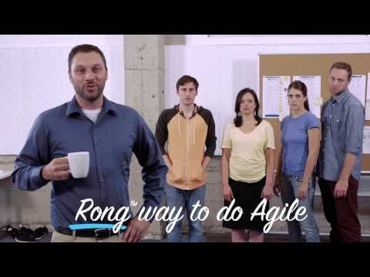
RETROSPECTIVE: Anti-patterns

Slide 6





RETROSPECTIVE: Guidelines
Shorten the time between each one.
Have ground rules for the session visible.
Start with an update on previous retrospective items.
Focus discussions on what you are able to change.
Always end on a high note.

Slide 7
RETROSPECTIVE: Popular Formats
Round the circle reflection
Stop/Start/Continue/(More/Less)
Happy/Sad/Glad
Timeline
Deep dive on specific problem area
Fishbone
5 Whys

Slide 8
The Retrospective Prime Directive
"Regardless of what we discover, we understand and truly believe that everyone did the best job they could, given what they knew at the time, their skills and abilities, the resources available, and the situation at hand."
--Norm Kerth, Project Retrospectives: A Handbook for Team Review
Notes:
The purpose of the Prime Directive is to assure that a retrospective has the right culture to make it a positive and result oriented event. It makes a retrospective become a effective team gathering to learn and find solutions to improve the way of working.

Slide 9
The Retrospective Safety Check
Ask participants to choose a number between 1 and 5 that indicates how safe they feel within the group.
5 - No Problem, I’ll talk about anything
1 - I’ll smile and be calm; everything is great and agree with the managers
The numbers should be taken anonymously.
Acknowledge the result and decide what’s next...
Notes:
Retrospectives should be a place where ALL participants feel safe and comfortable. Before starting the Retro conduct a ‘Safety Exercise to determine everyone’s comfort level and willingness to participate.
Below is the meaning for each number:
5 - No Problem, I’ll talk about anything
4 - I’ll talk about almost anything; a few things might be hard
3 - I’ll talk about some things; but others will be hard to say
2 - I’m not going to say much, I’ll let the others bring up the issues
1 - I’ll smile and be calm; everything is great and agree with the managers

Slide 10
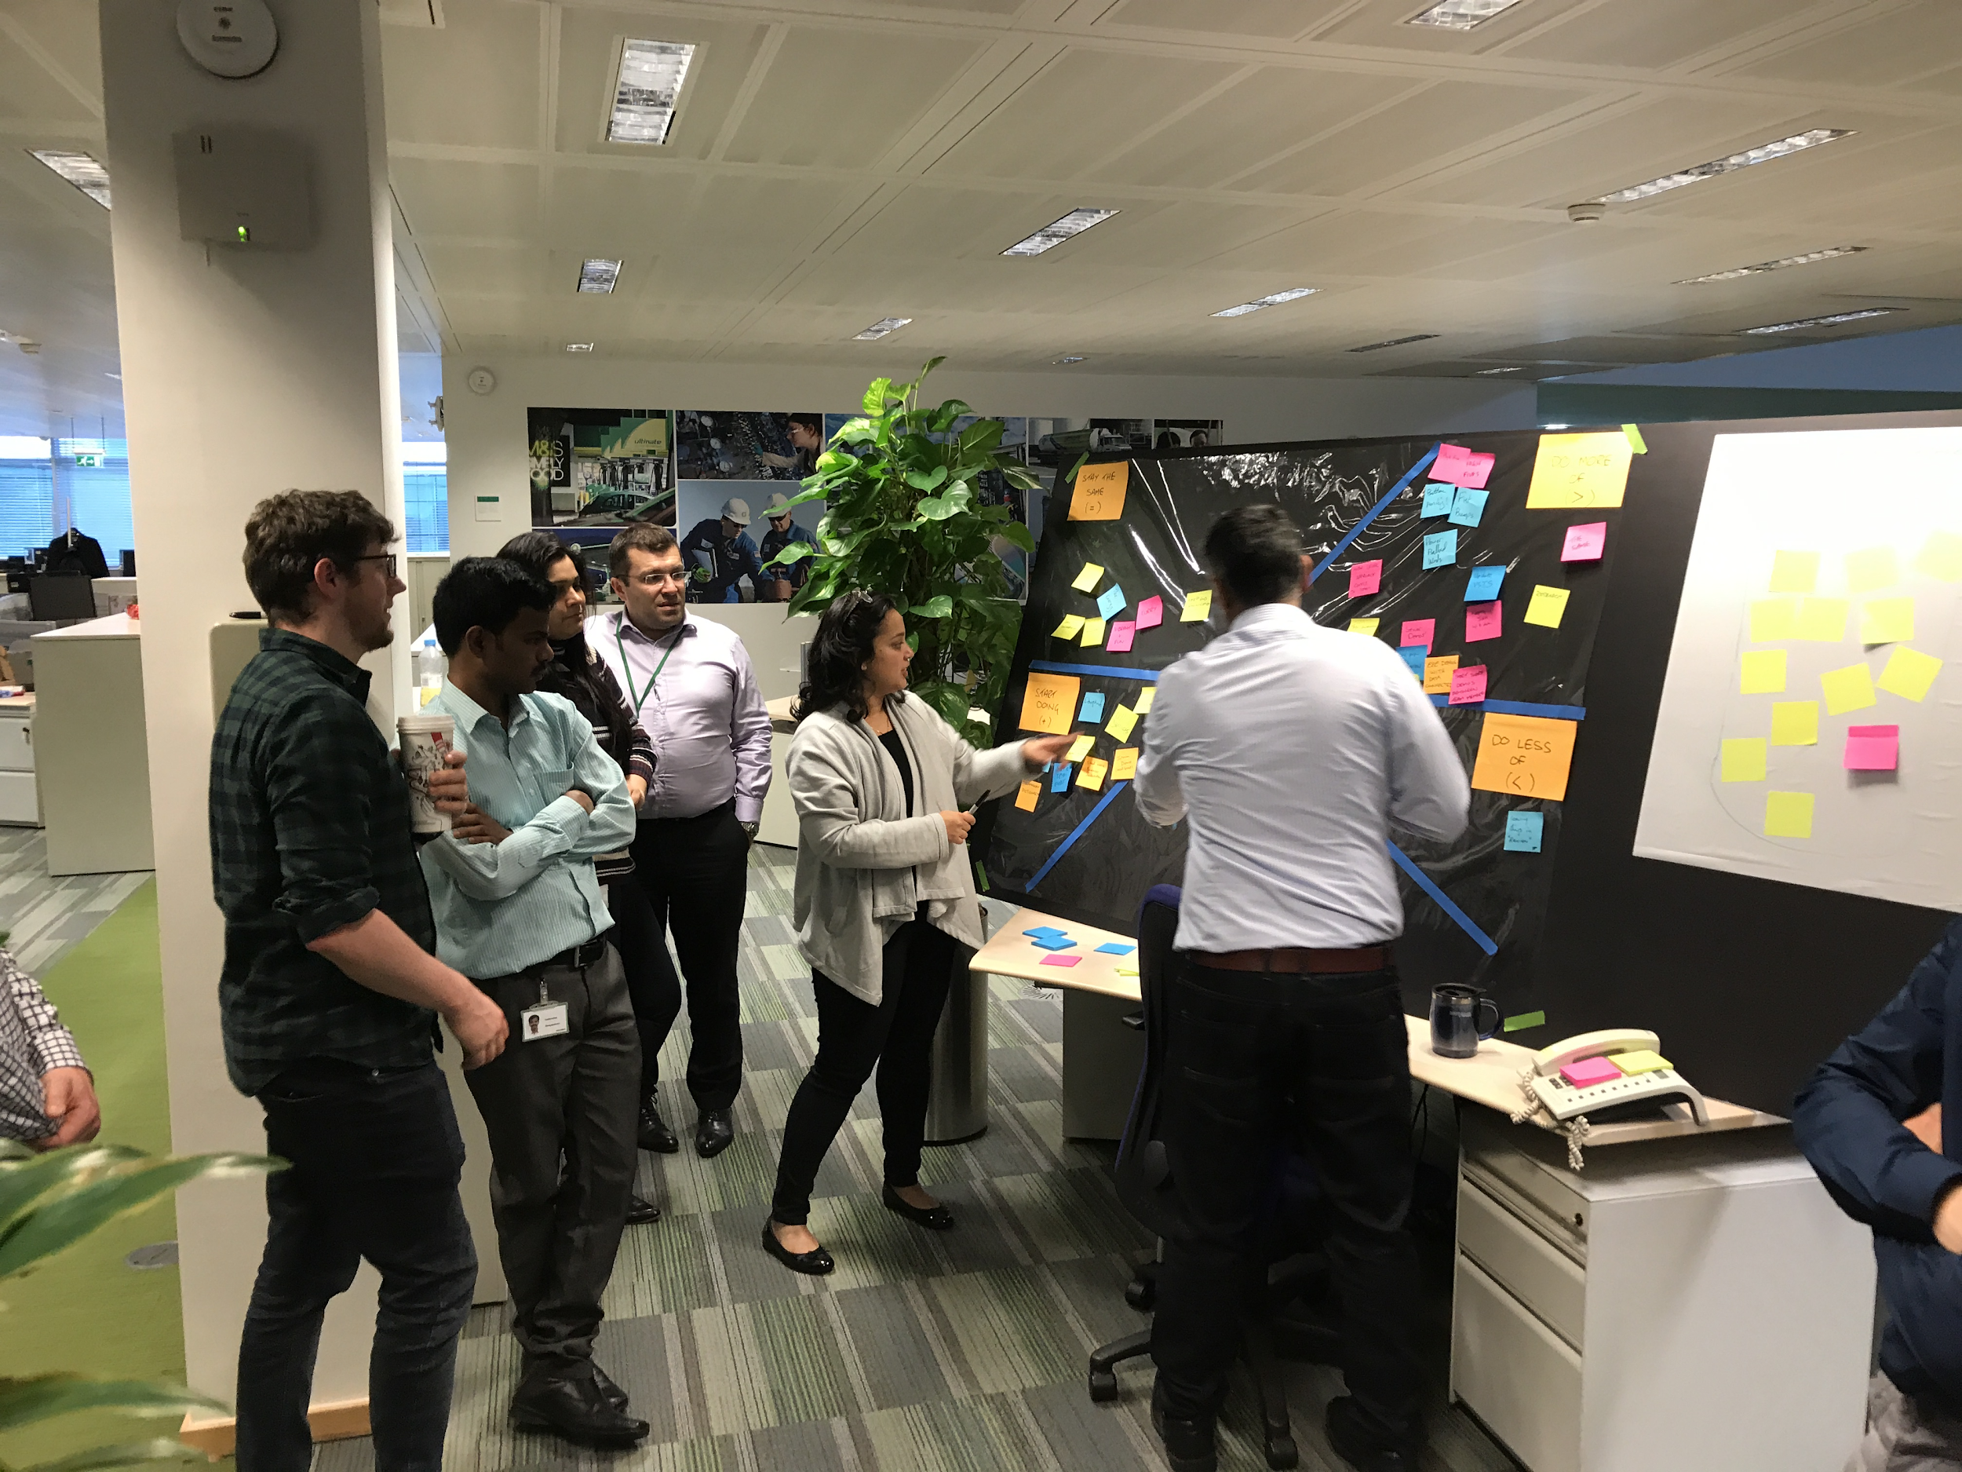
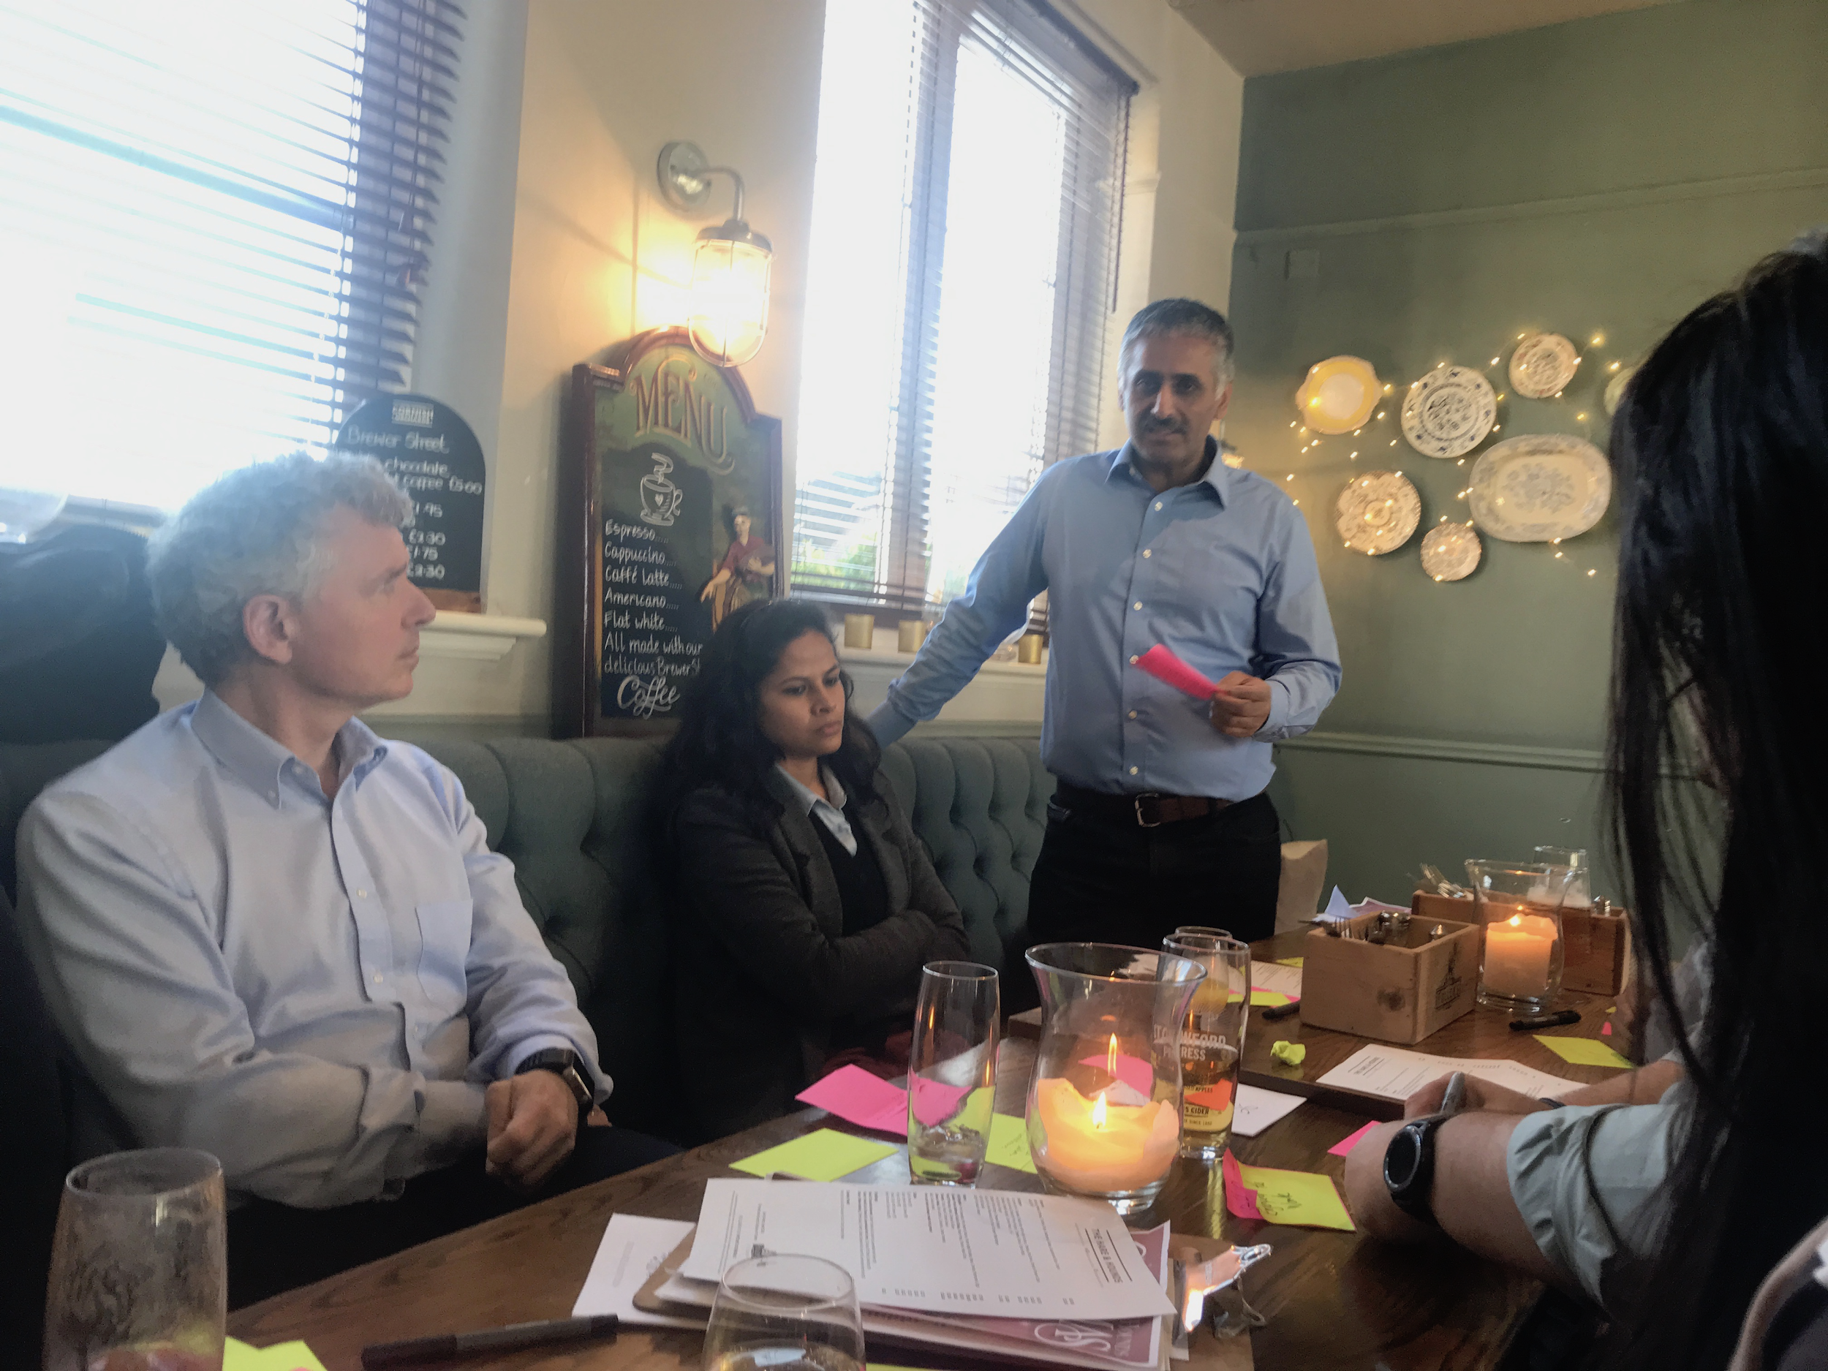
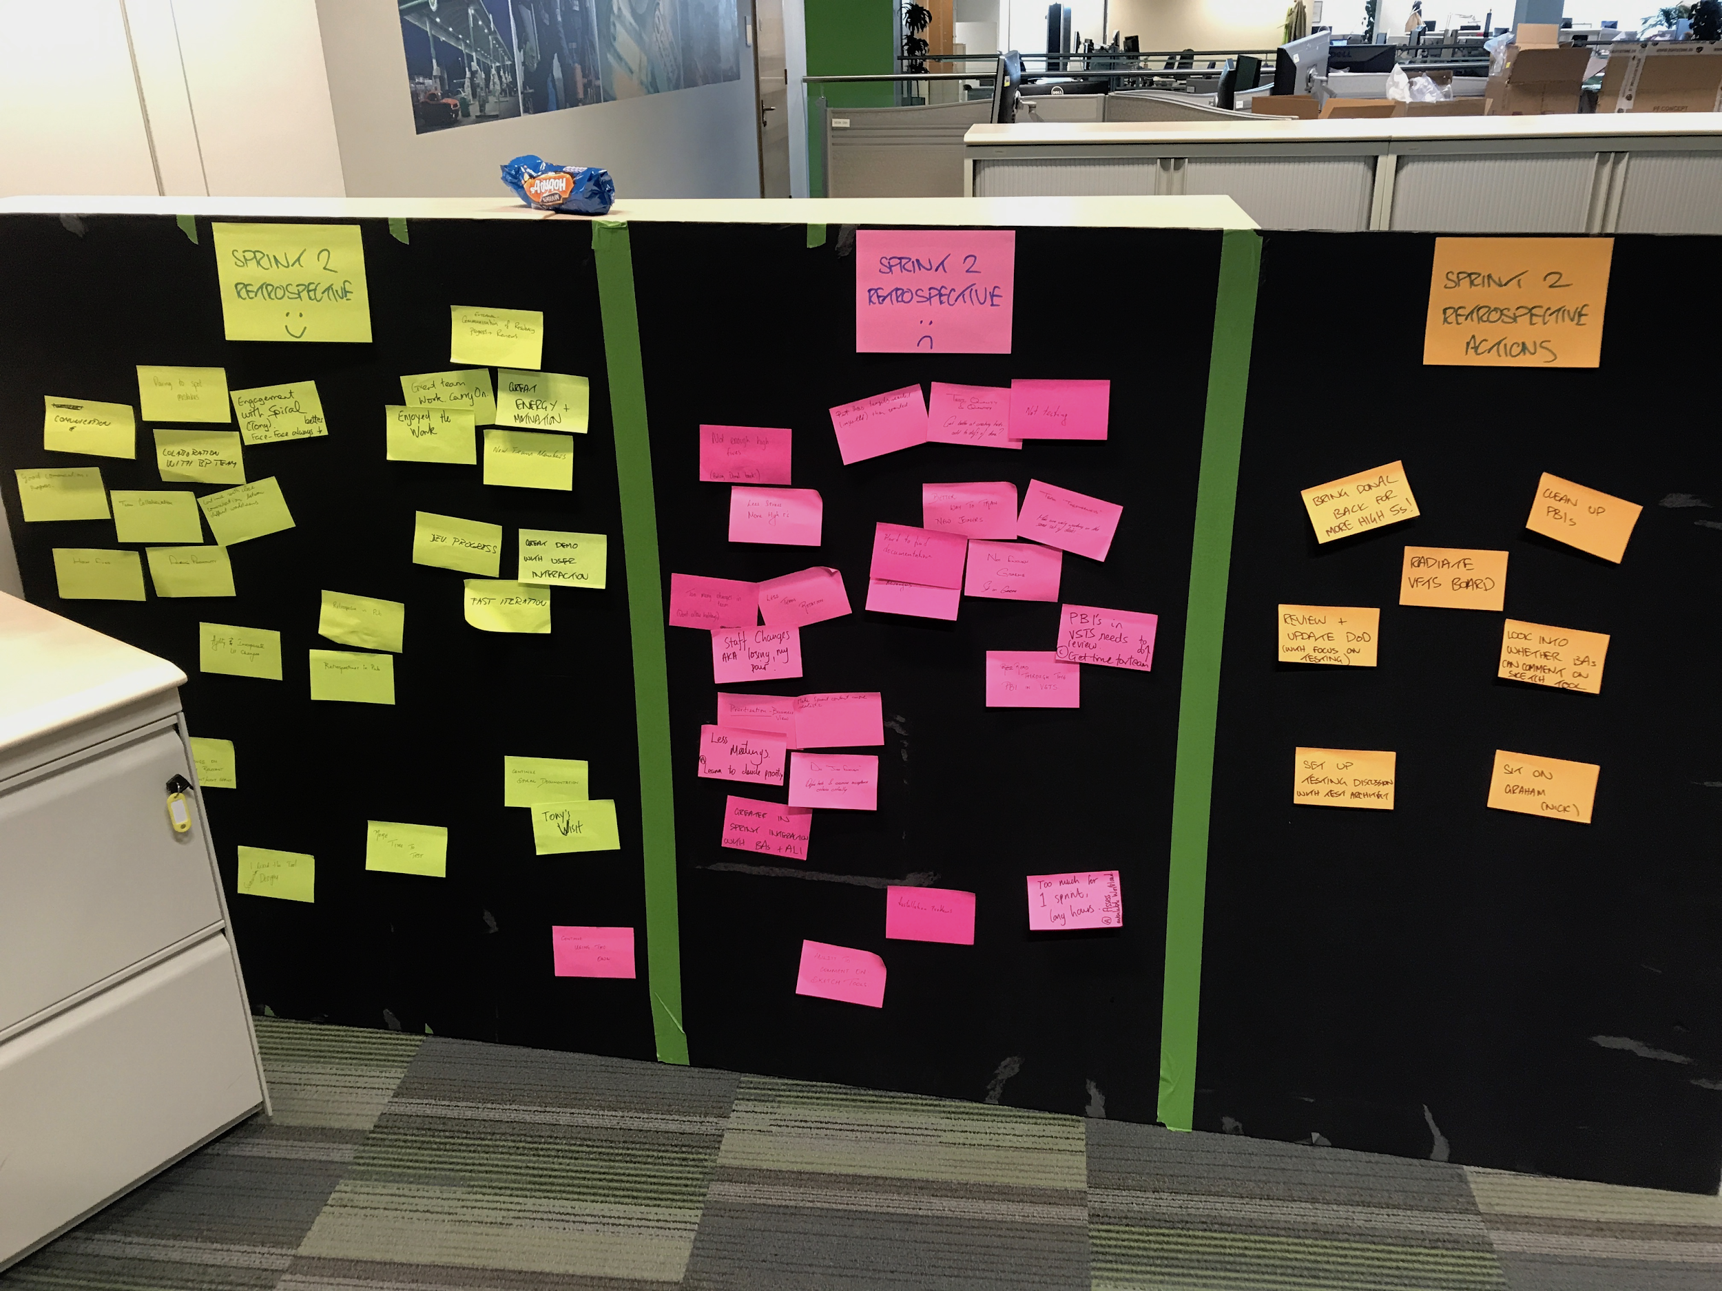
Example Retrospectives from Labs Residencies - BP

Slide 11
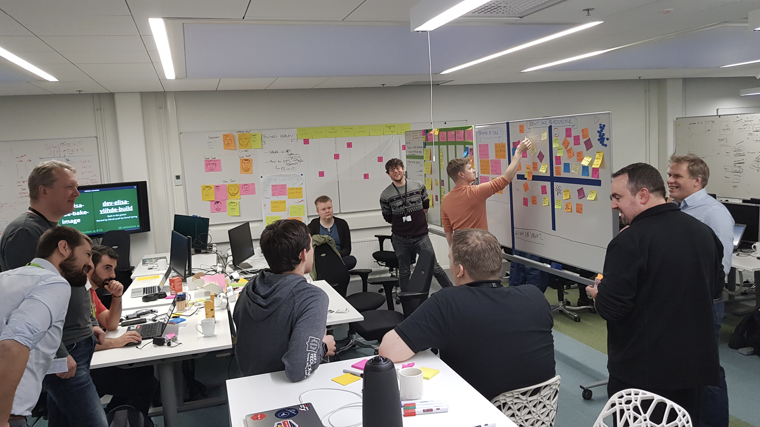
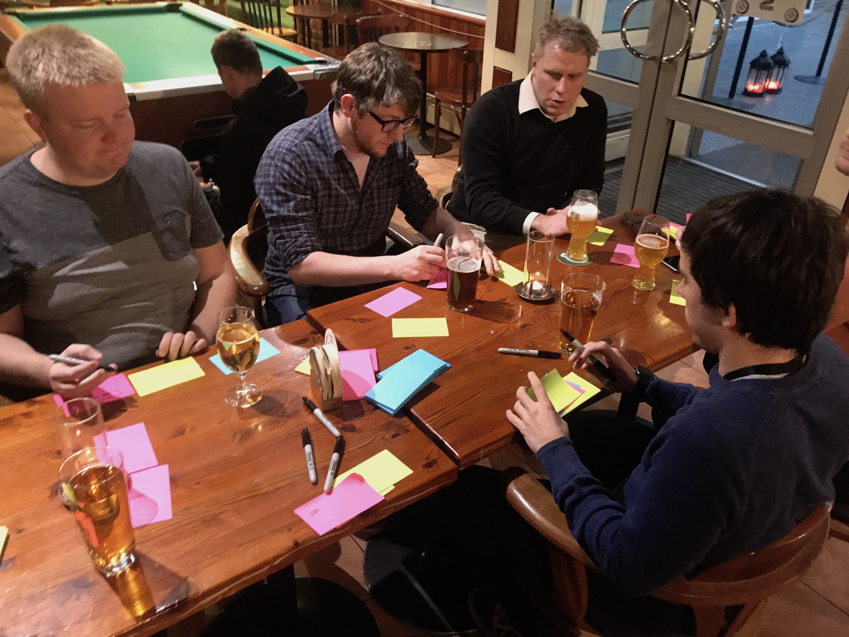
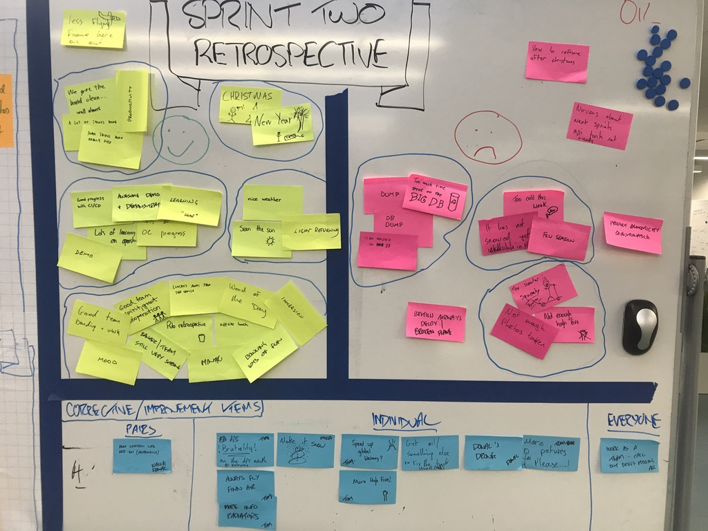
Example Retrospectives from Labs Residencies - Elisa

Slide 12
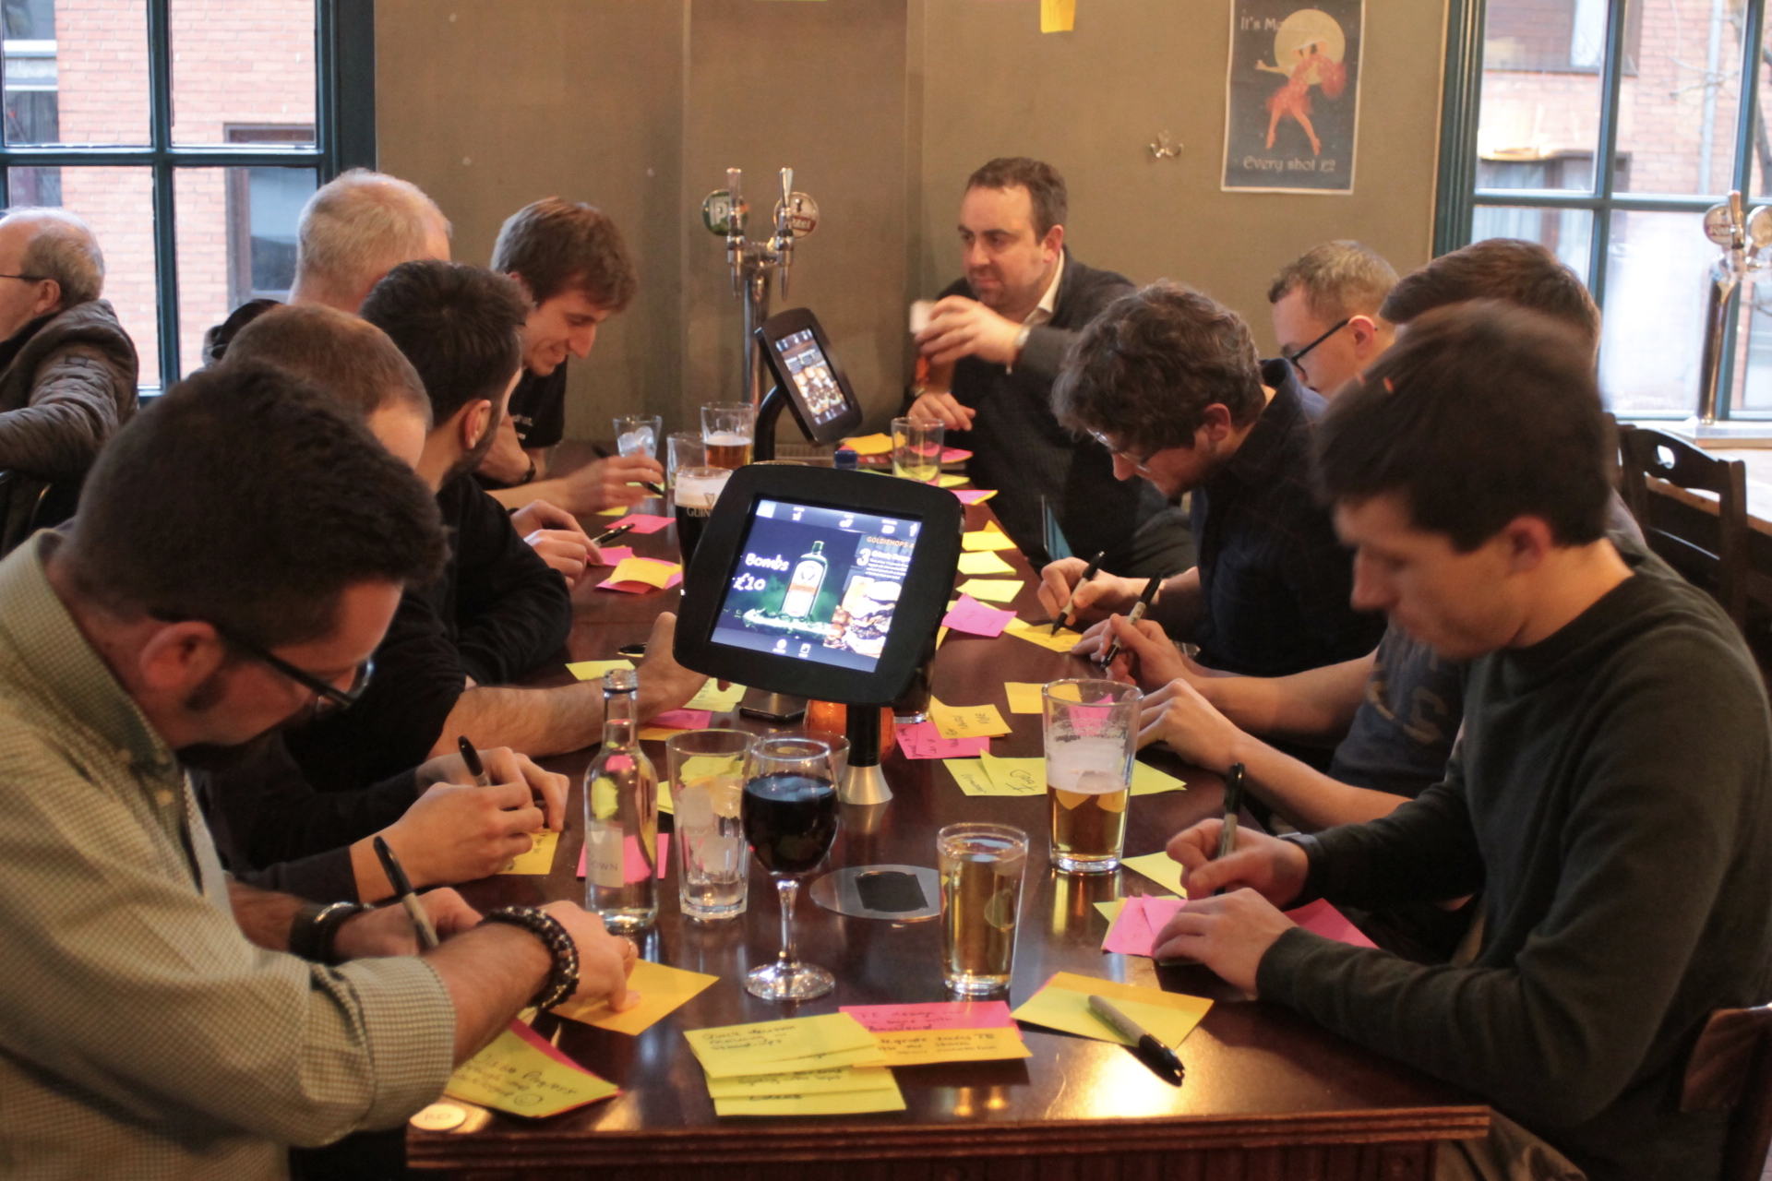
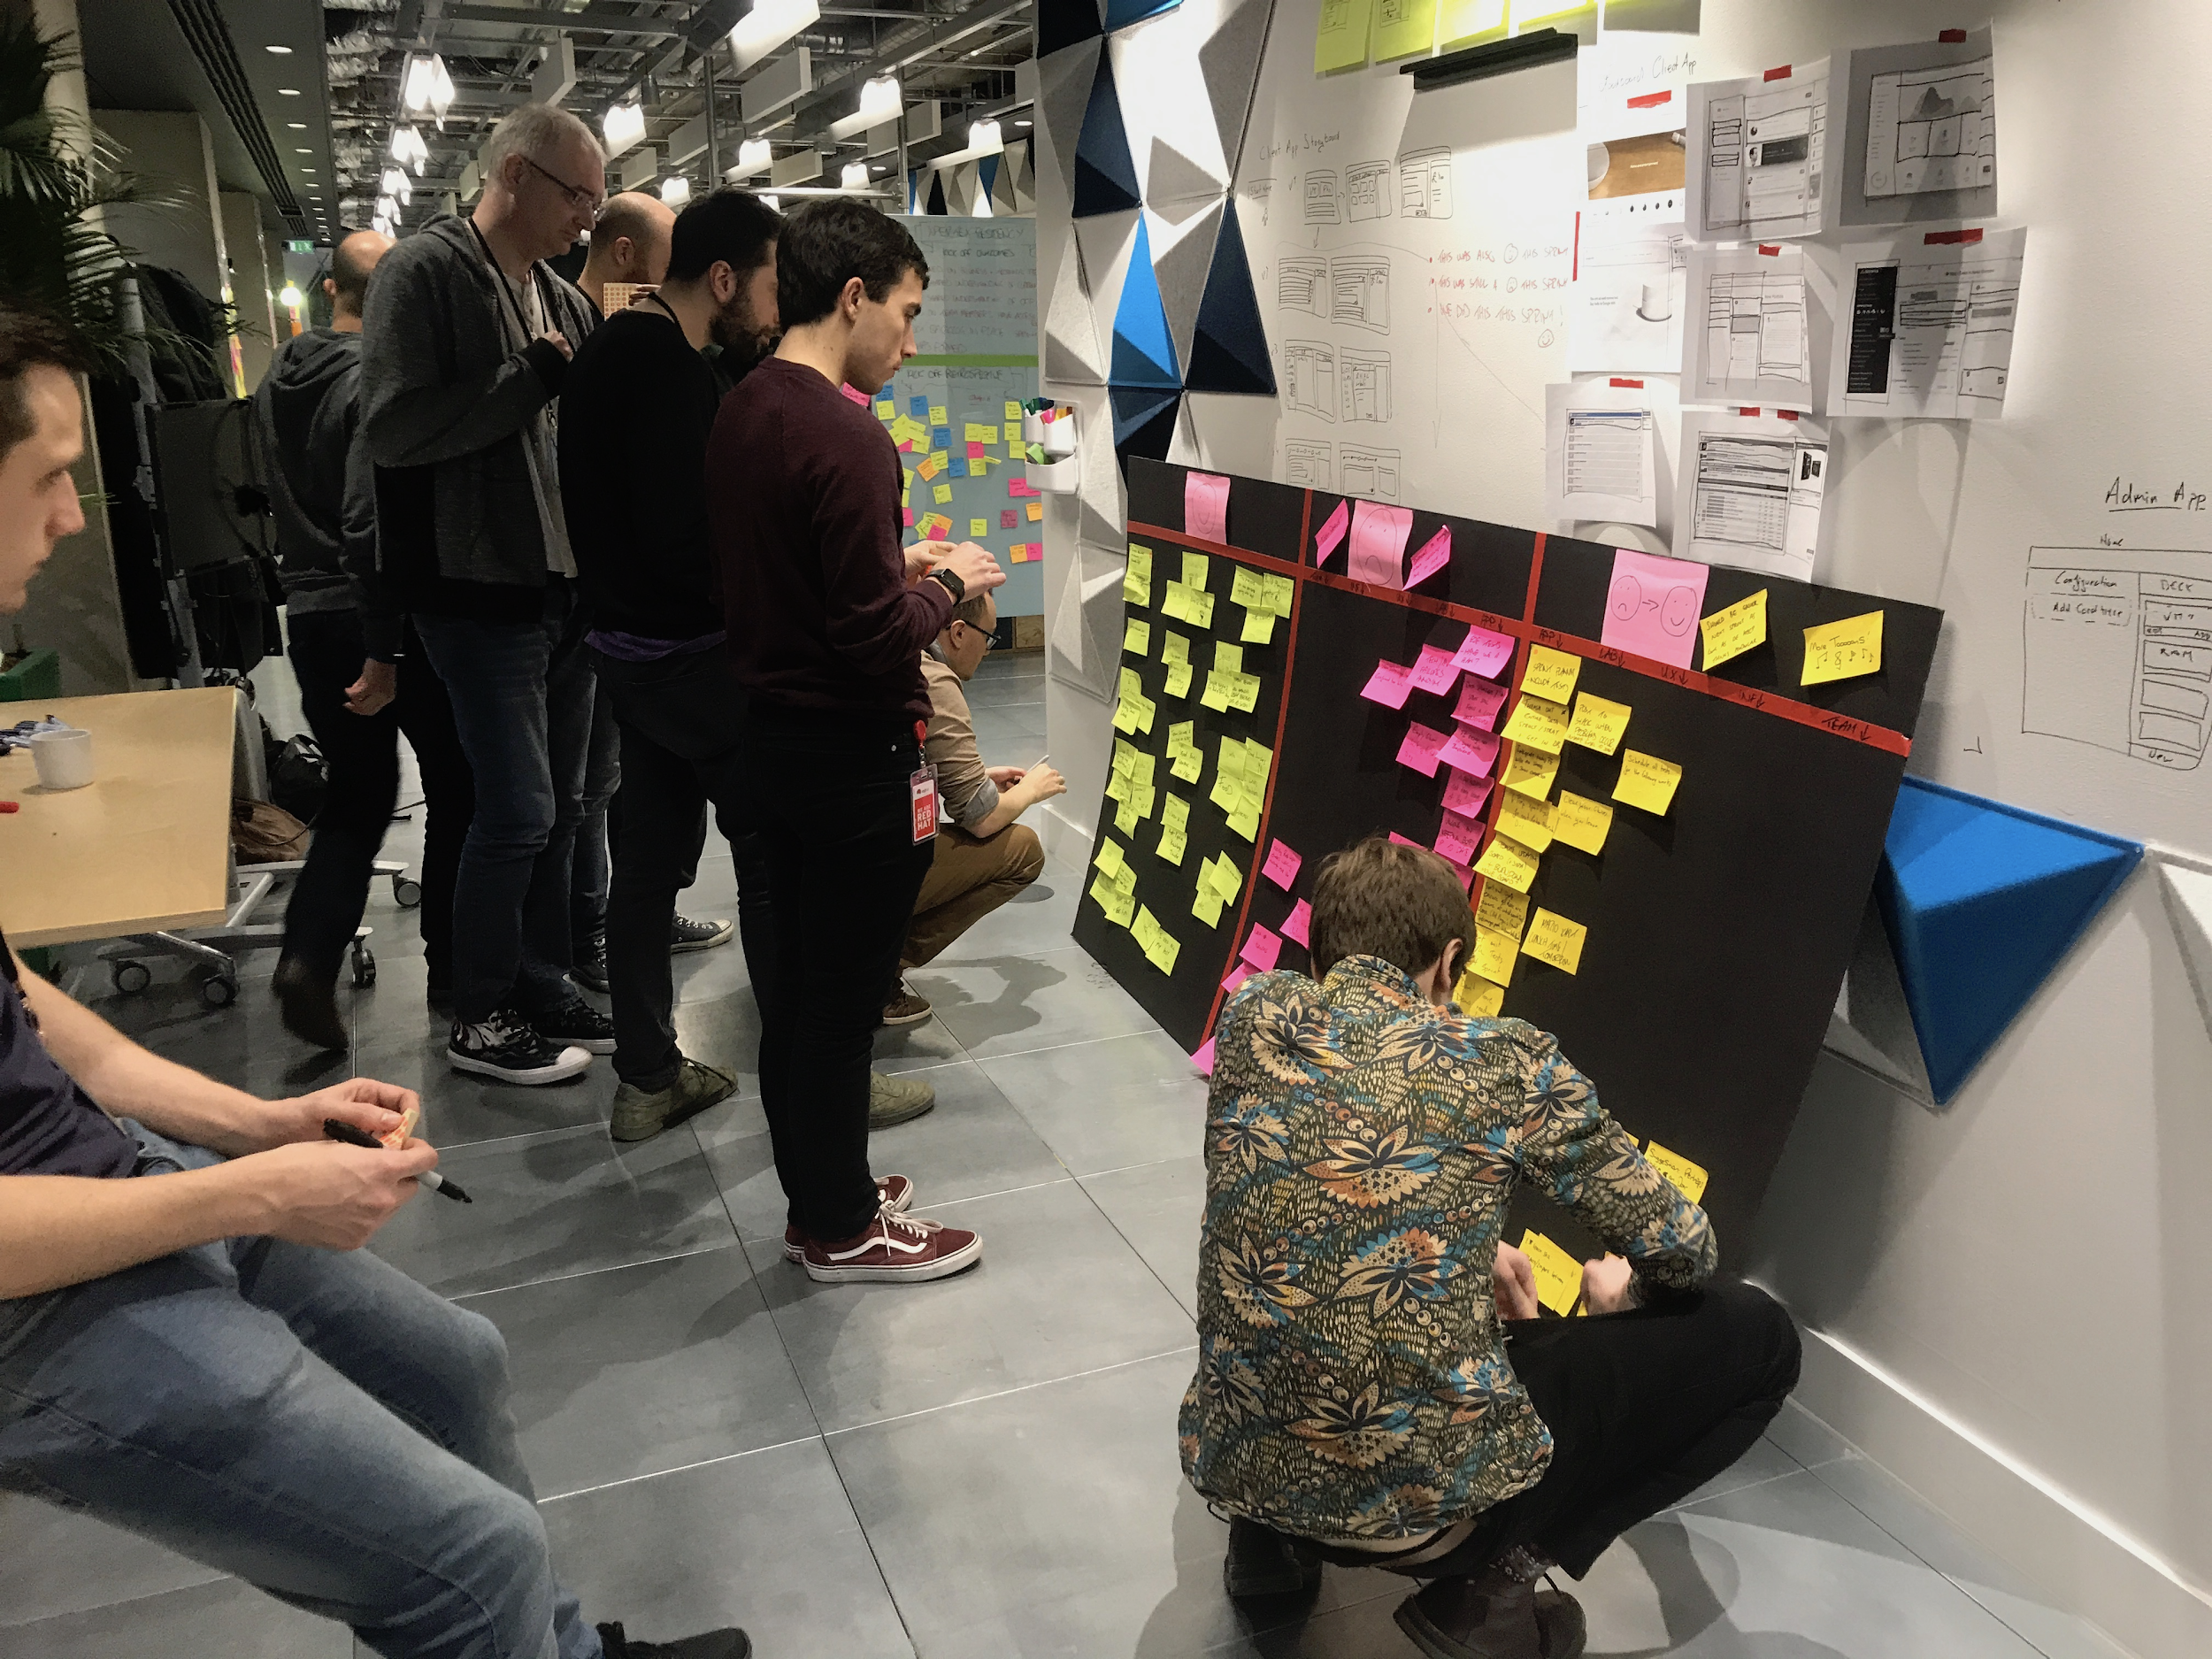
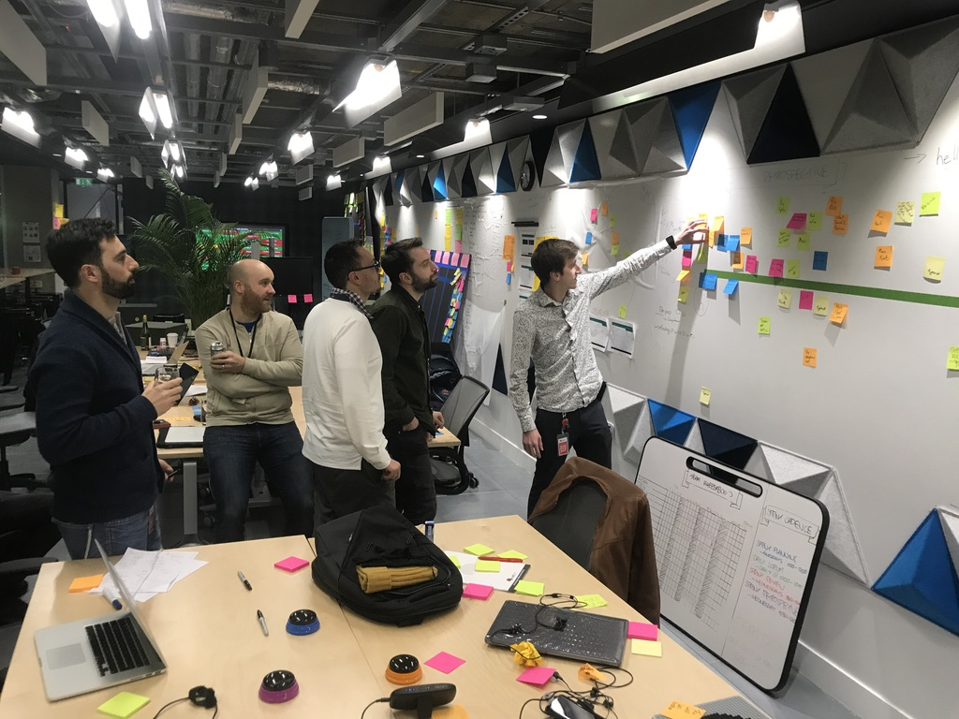
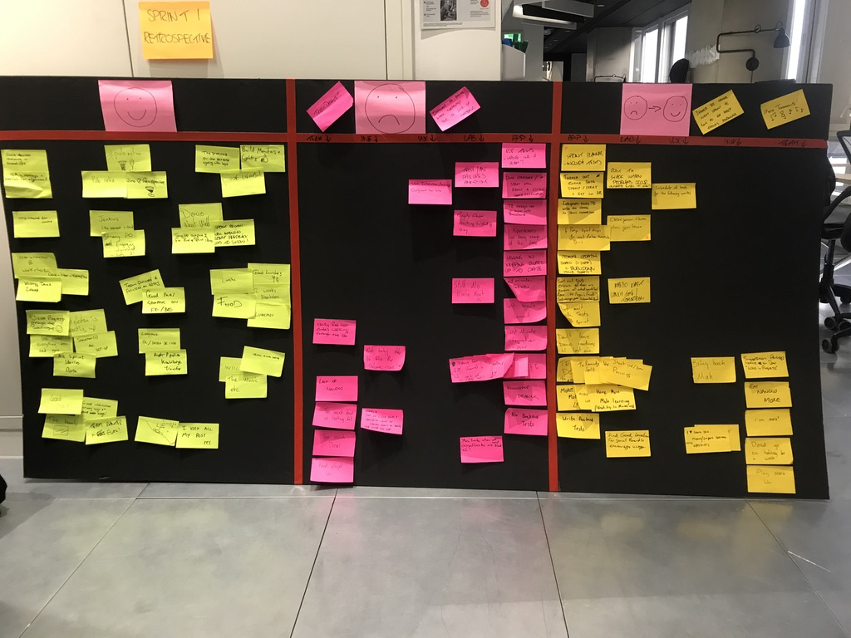
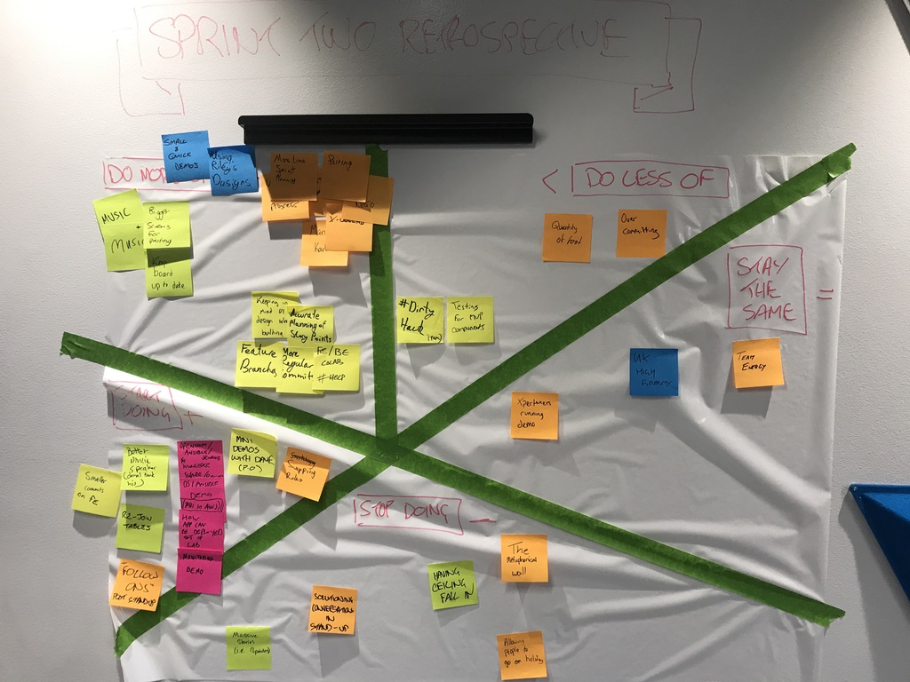
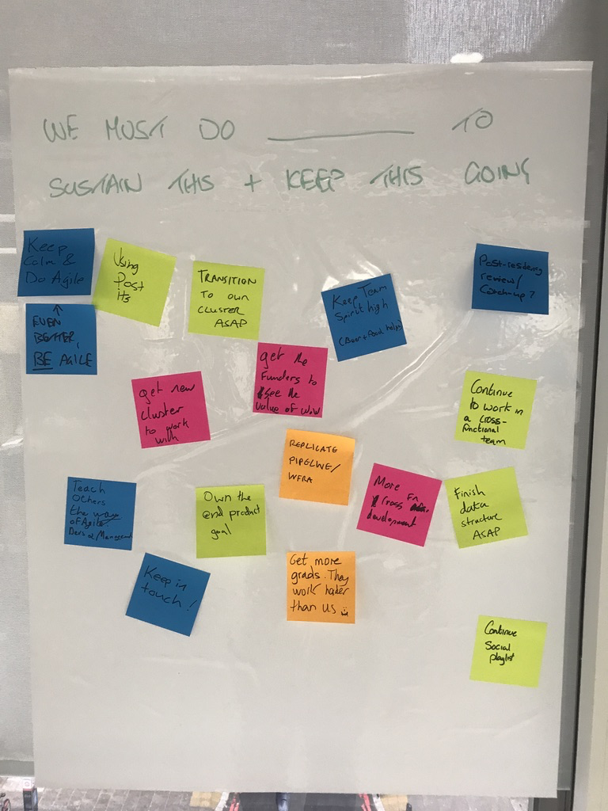
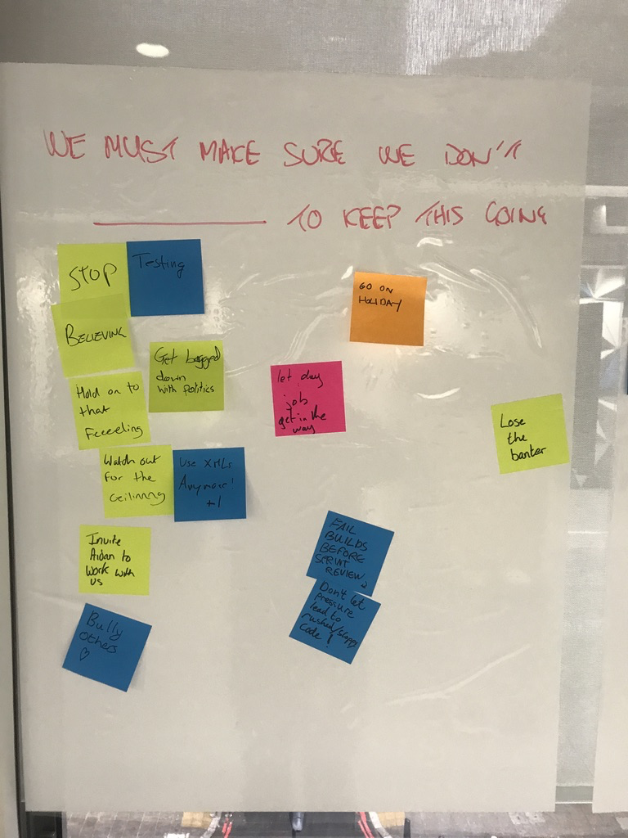
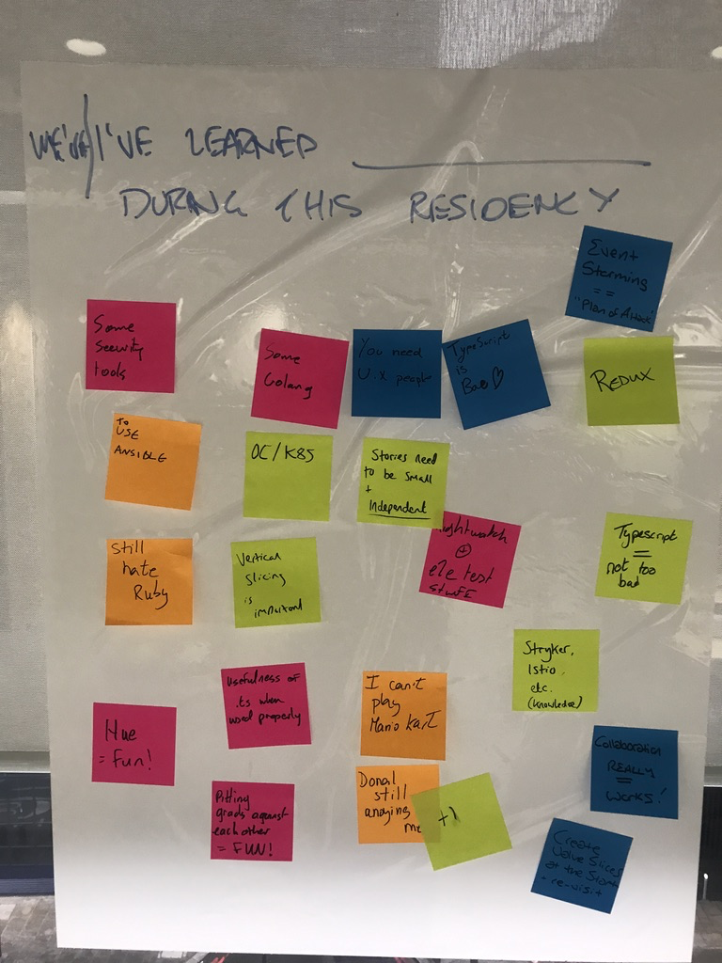
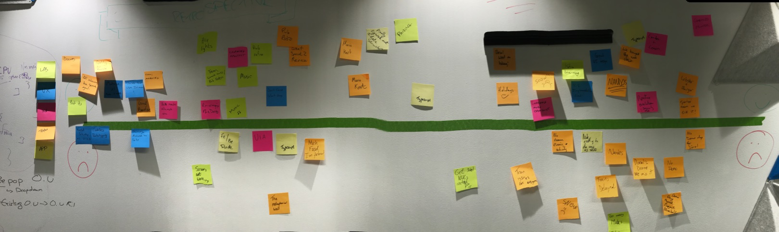
Example Retrospectives from Labs Residencies - Xpertex

Slide 13
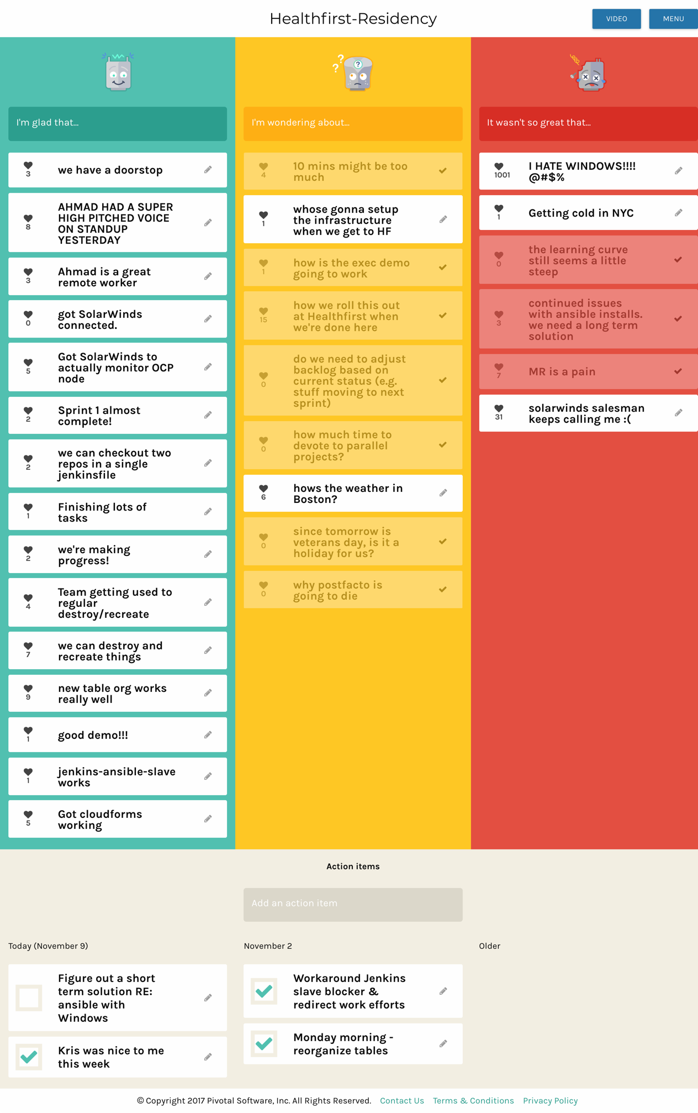
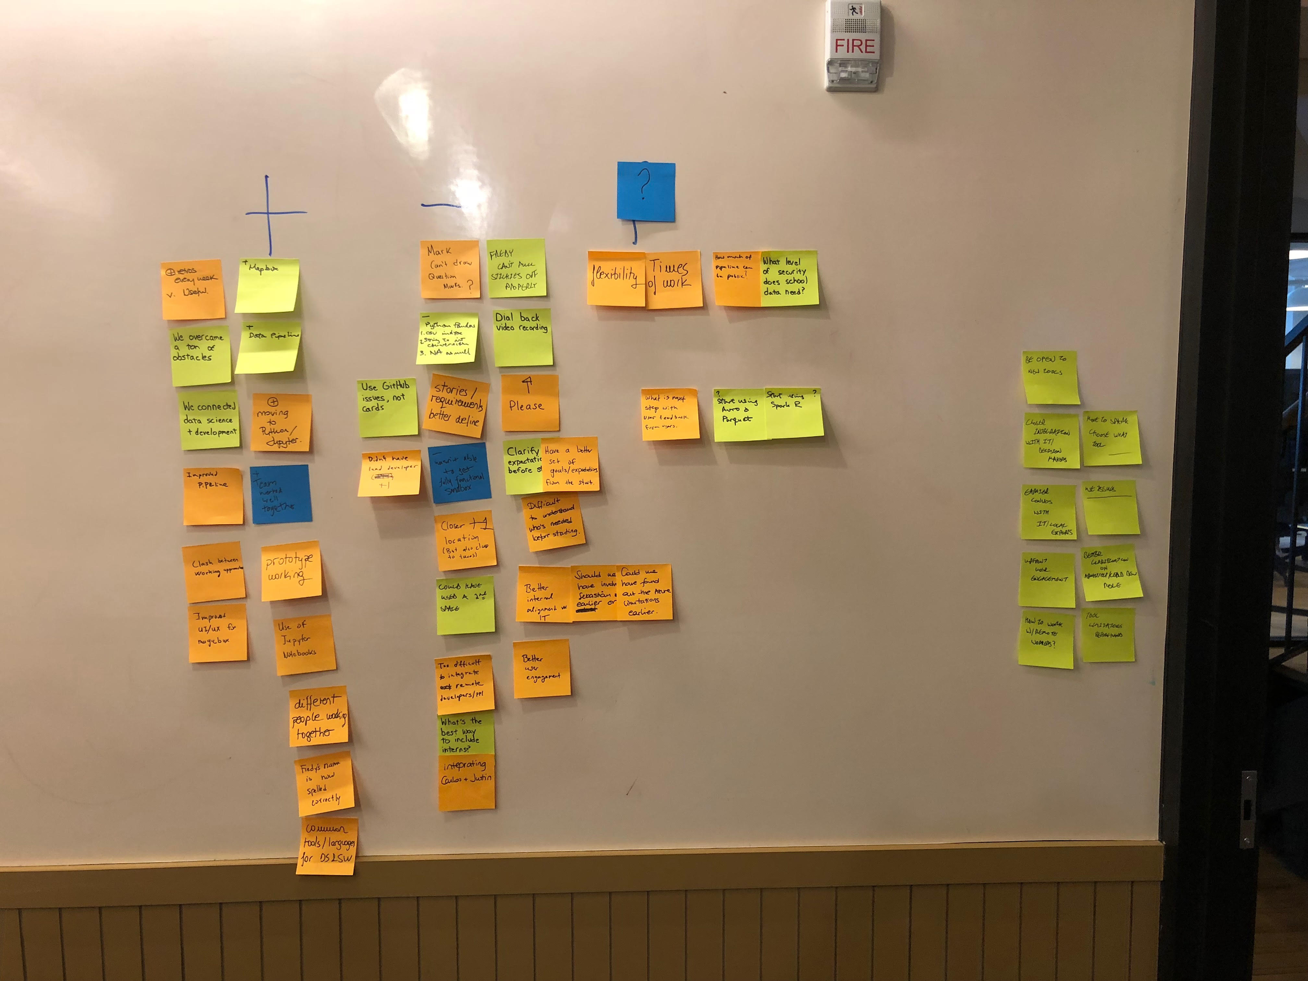
Example Retrospectives from Labs Residencies - Healthfirst

Slide 14
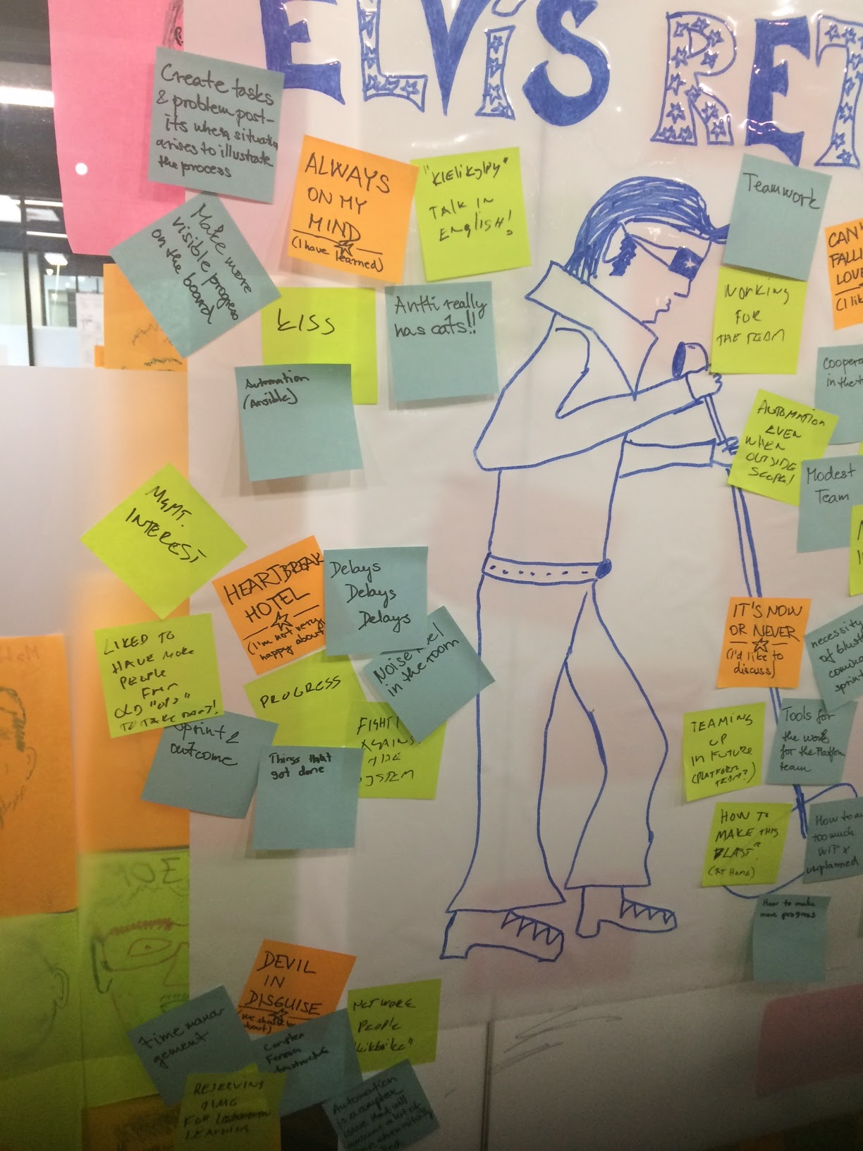
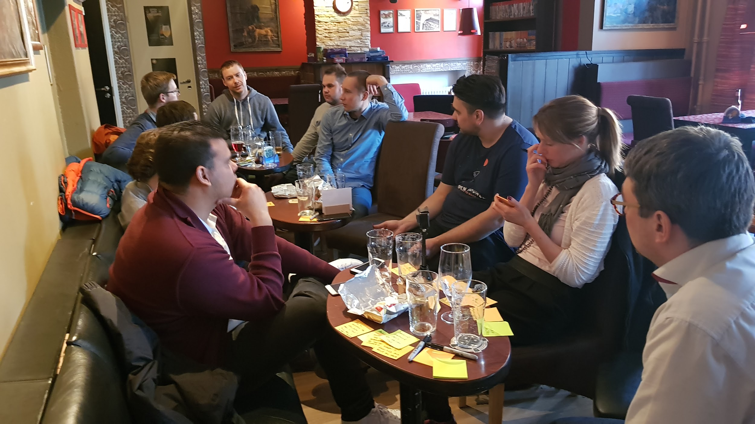
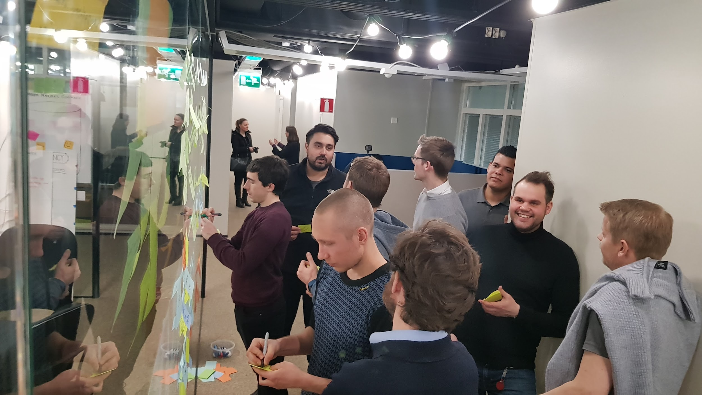
Example Retrospectives from Labs Residencies
Notes:
Fennia

Slide 15
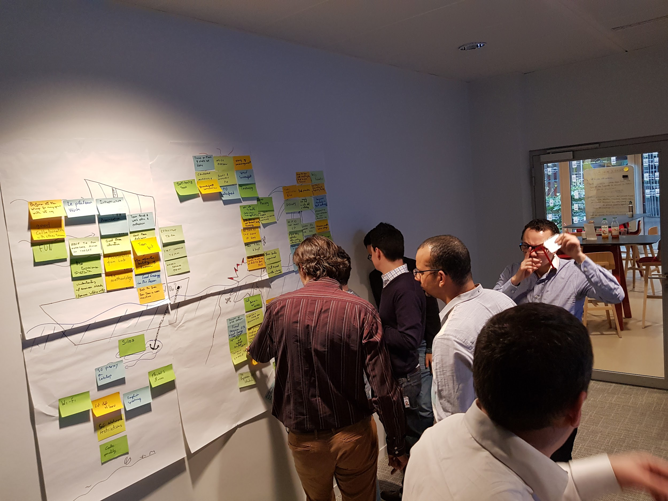
Example Retrospectives from Labs Residencies
Notes:
SocGen

Slide 16


PRACTICES USED IN THIS SESSION:
Retrospectives
Real-time Retrospective

